Slide 1
PYTHON PROJECT
By,
PRABHAA VN

Slide 2
EXAMPLE PROJECT
GAME FINDER GUESSING -
NUMBER TO WORD
WORD TO NUMBER

Slide 3
MODULE 1

Slide 4
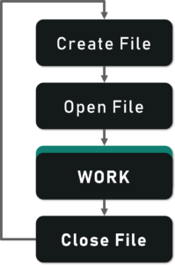
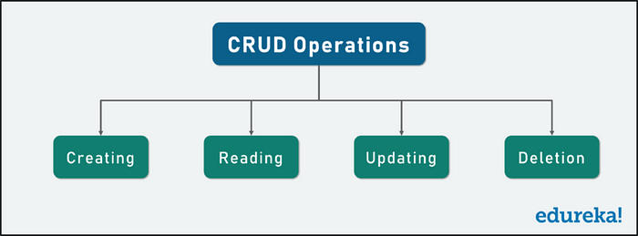
MODULE 1 EXPLANATION

Slide 5
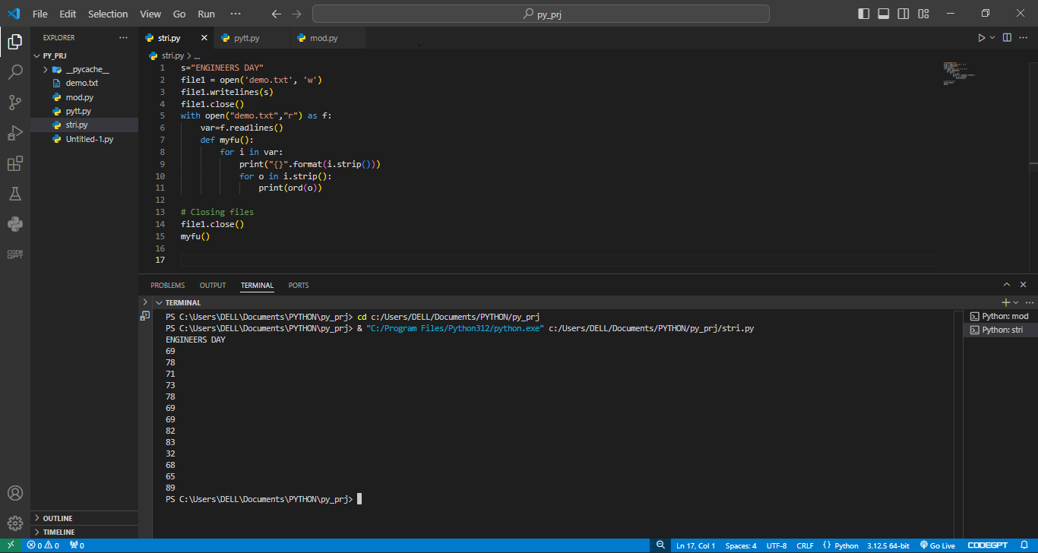

Slide 6
MODULE 2

Slide 7
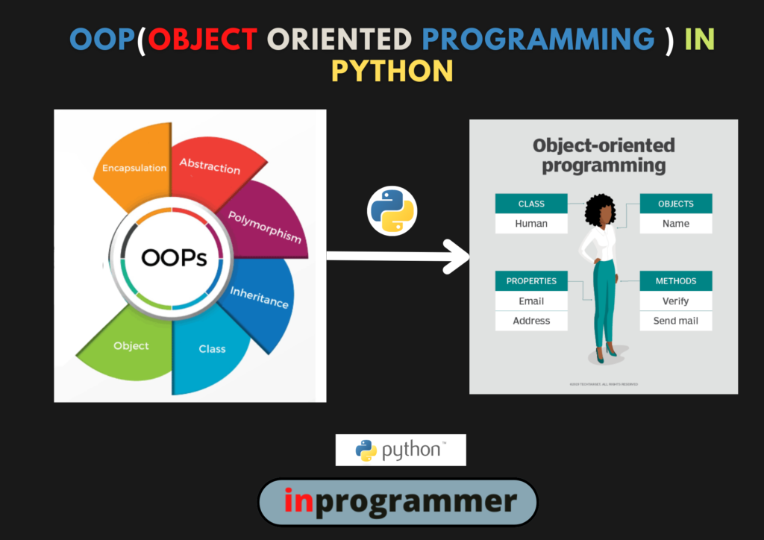
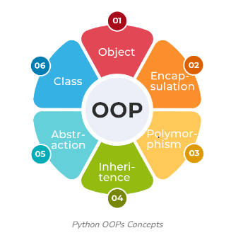
MODULE 2 EXPLANATION

Slide 8
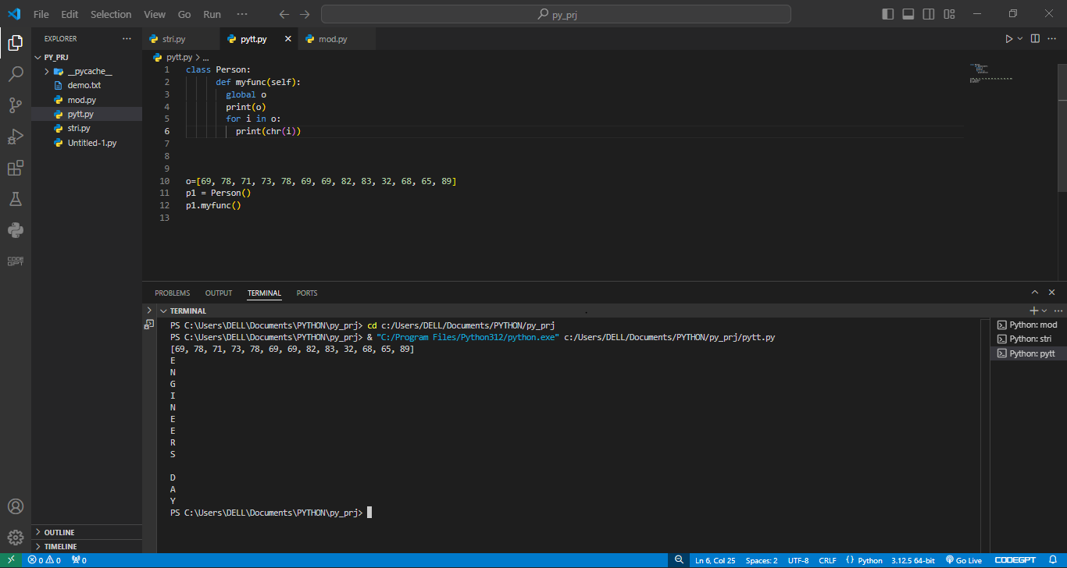

Slide 9
MODULE 3

Slide 10
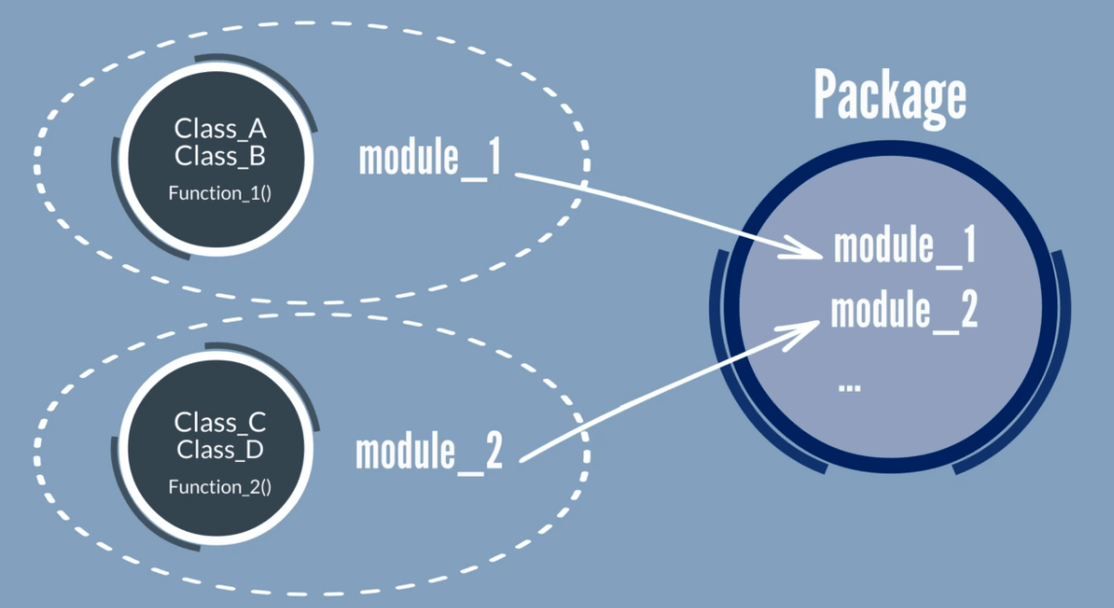
MODULE 3 EXPLANATION

Slide 11
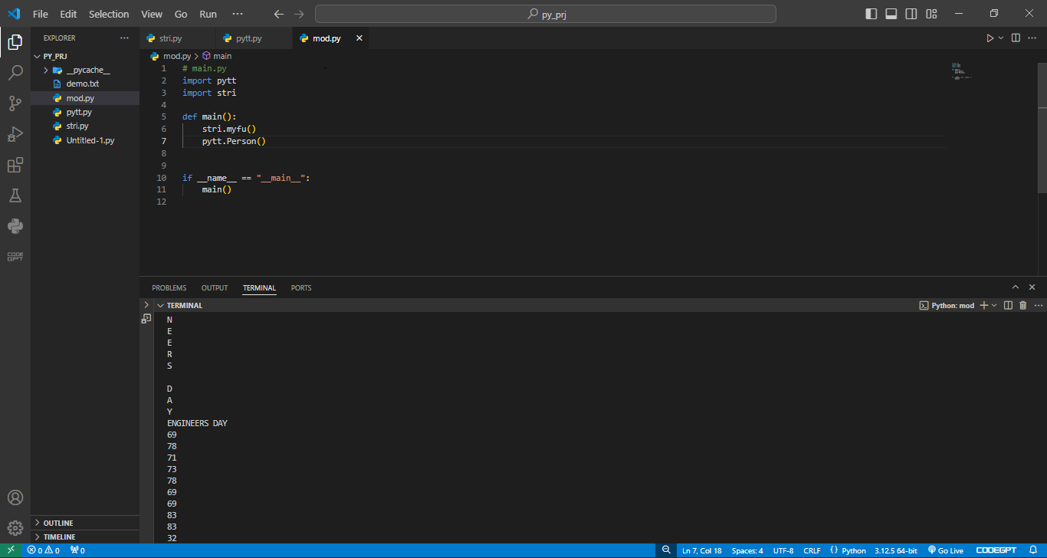

Slide 12
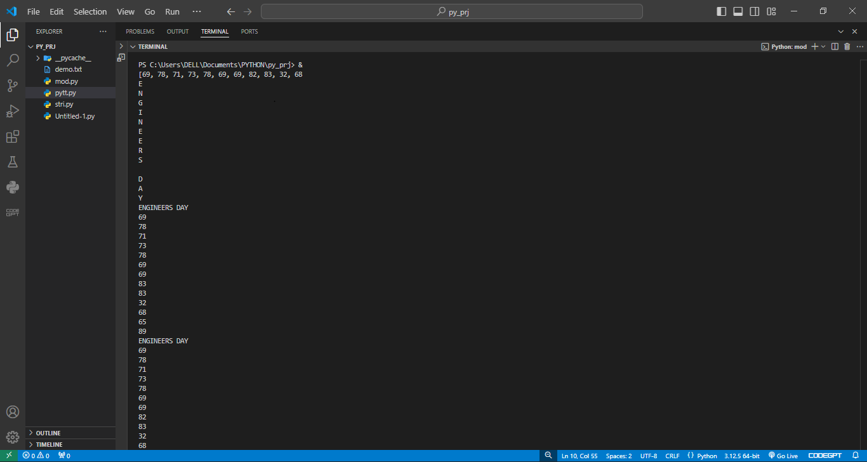
myfu()

Slide 13
tHANK YOU..

